Slide 1

Apache Kafka: Scalable Real-Time Data Streaming
MILESTONE 2
GROUP 5

Slide 2





Agenda
Streaming technology Intro
What is Kafka
Why Kafka & Uses of Kafka
Core concepts’
Architecture Overview
How it works
Real world use
Advantages
Limitations

Slide 3
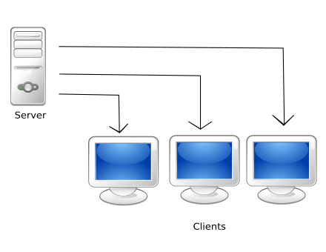
What is Streaming ?
Streaming means continuous flow of data — like a river of information.
It refers to real-time data processing where data is processed as soon as it is generated.
Contrast to batch processing (processes data after collection).
Used in scenarios like: live financial trades, patient vitals, social media feeds, sensor readings.
What is a platform?
A platform is a base system that provides tools and an environment to run or build other applications.
Kafka is a data streaming platform – it supports developers to create, manage, and process real-time data.
This Photo by Unknown Author is licensed under CC BY-SA

Slide 4
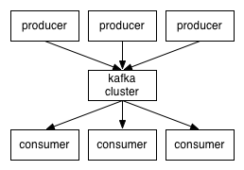
What is Apache Kafka?
Apache Kafka is like a postal system for data. It lets software applications send and receive data messages reliably and in real time.
Used to build data pipelines and real-time streaming apps.
Originally built at LinkedIn and later open-sourced through Apache.
Trusted by companies to handle trillions of events every day

Slide 5
Why Kafka & use cases of kafka:
High-throughput and low-latency messaging
Scalable horizontally
Persistent, durable message storage
Enables event-driven architecture
Used cases of kafka
Real-time analytics and dashboards
Microservices communication
Data lake ingestion pipelines
Internet of Things (IoT)
Machine Learning pipelines
Financial transactions monitoring
Health monitoring systems (e.g., patient vitals)

Slide 6
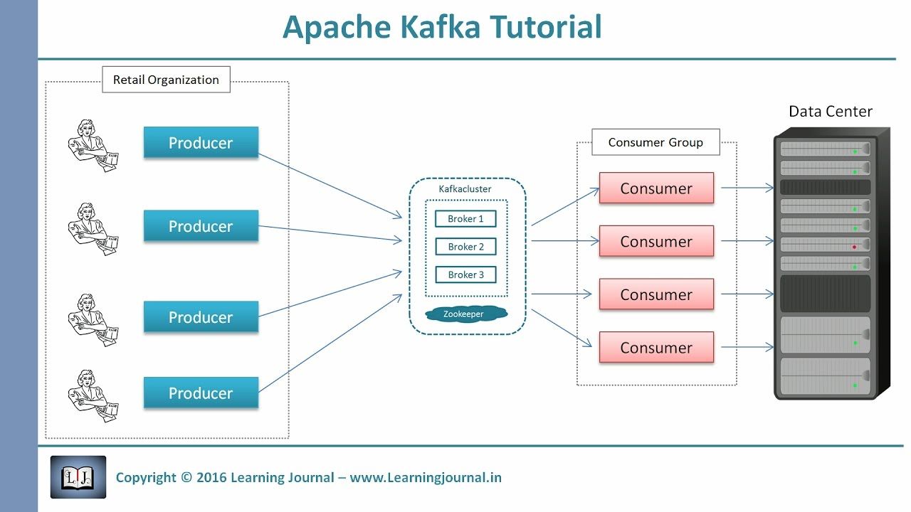
Kafka Core Concepts
Producer: Sends data (events)
Topic: Named channel to which records are sent
Partition: Allows parallelism and scalability
Broker: Kafka server that stores data
Consumer: Reads data from topics
Consumer Group: Multiple consumers share the load
Offset: The unique ID for each message in a partition
Metadata: Data about Kafka’s structure - topics, partitions, brokers

Slide 7
Kafka Architecture Overview
]
Producers write to topics
Topics are split into partitions
Brokers manage partitions
Consumers pull data
Zookeeper (or KRaft) manages cluster metadata
How Kafka Works
Producers send messages to Kafka topics.
Messages are stored in topic partitions in order (with unique offsets).
Brokers manage and store these partitions.
Consumers read messages from topics using offsets.
Zookeeper/KRaft handles cluster coordination and metadata.

Slide 8
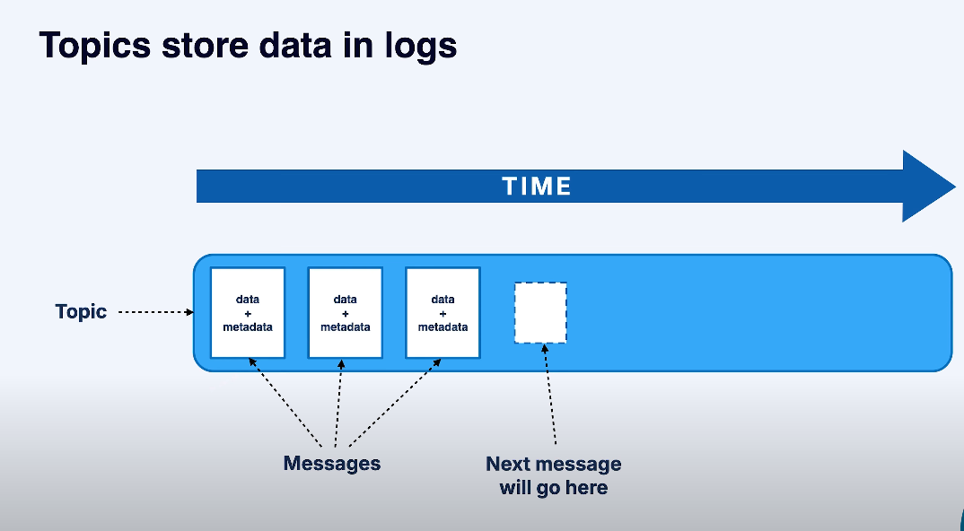

Slide 9
How Kafka Works?
Kafka Real-Time Data Flow Example
Scenario: E-commerce Website – User Activity Tracking
User visits website – triggers events like clicks, views.
Producer app sends events (user ID, time, action) to Kafka topic user-activity.
Kafka brokers store events in partitions.
Consumers read data – one saves to database, another sends alerts or real-time recommendations.
Data is processed live for dashboards, personalization, or fraud detection.

Slide 10
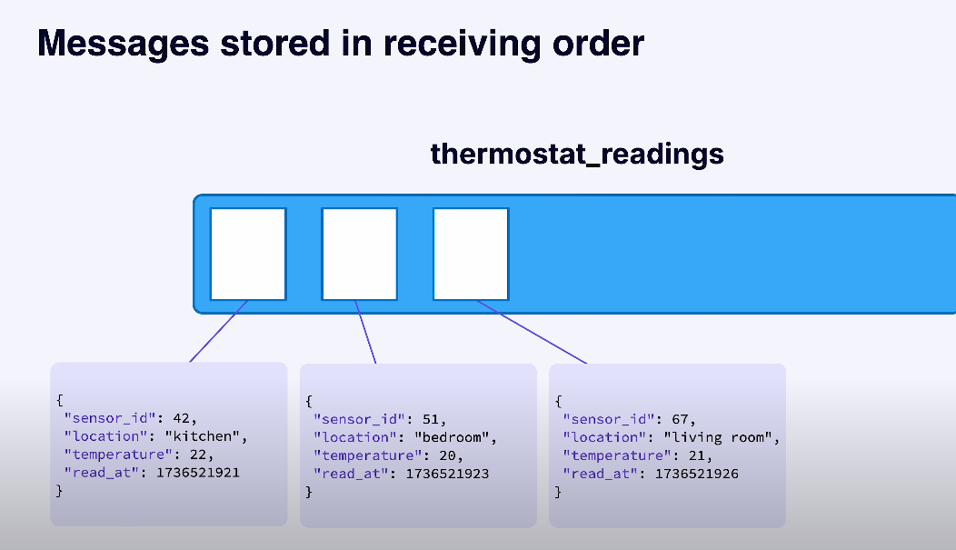

Slide 11
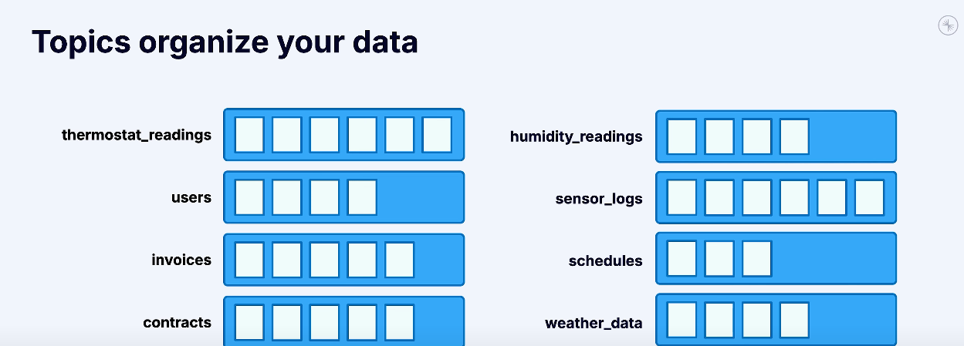

Slide 12




Real-World Use Cases
Uber: Real-time trip/event tracking.
Netflix: Monitoring and personalized recommendations.
LinkedIn: Data sync and user activity streams.
Goldman Sachs: Market data ingestion and fraud detection.

Slide 13
Strengths of Kafka
Horizontal scalability and fault tolerance.
Real-time and batch processing support.
Reliable ordering within partitions.
Message durability and replay.
Large ecosystem and open standards.

Slide 14
Limitation of Kafka
Steep learning curve.
Cluster management overhead.
Ordering only within partitions.
Manual patterns for features like dead-letter queues.
Needs tuning for large-scale performance.

Slide 15
When to Use Kafka
High-throughput pipelines and real-time apps.
Event-driven microservices.
Change data capture (CDC).
Analytics, observability, and log aggregation.
Decoupling systems and enabling asynchronous processing.

Slide 16



THANK YOU

